Slide 1

Lecture 20: Fourier Transform and Speech Recognition
University of Southern California
Linguistics 285
USC Linguistics
November 8, 2015
Lecture 20: Fourier Transform and Speech

Slide 2
Fourier Analysis (Fourier Transform)
e How do we find the frequencies that compose a signal?
e In a simple case, we can find them by careful observation of a waveform
10 ms
1
0
-0.9946
0
0.013
Time (s)
e But not in a more complex case
Lecture 20: Fourier Transform and Speech
Notes:
מה זה גל? גל זה סופרפוזיציה של גלים- גלים פשוטים יותר. מי שלמד פיזיקה- מעולה. מי שלא- זה בגדול הפרעה במרחב (במקרה של אור- מורכב יותר, קול- הפרעה בצפיפות האוויר בנקודה). אנחנו מודדים את השינוי בנקודת זמן במרחב ומציגים את זה. מסתבר שאפשר לפרוס גל לתדירויות שמרכיבות אותו- זה טרנספורם פוריה. תחשבו על פירוק וקטור לרכיבים בR3- דומה, אבל באינסוף מימדים, ועם פונקציות.

Slide 3
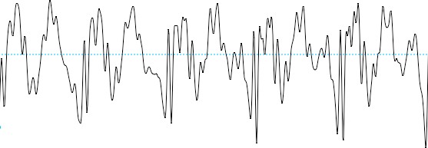
Fourier Analysis (Fourier Transform)
e How do we find the frequencies that compose a signal?
e Observation of waveform in simple, artificial case, but not in complex, real case
10 ms
1
/ih/ from “ship’’
0
10 ms
-0.9946
0
0.013
Time (s)
Lecture 20: Fourier Transform and Speech
Notes:
אפשר בגדול לפרק גל על ידי התבוננות נאיבית בו וקירוב למשהו מוכר של סינוס. אבל יש גם דרך מתמטית מפורטת לעשות את זה.

Slide 4
Fourier Analysis (Fourier Transform)
e Fourier Analysis is the technique that does this.
e Produces something called the Fourier Transform, which contains the information in the spectrum.
e But how does it work?
e By using the inner product!
e Take the inner product of the signal (waveform) with pure tones of all possible frequencies.
e The size of the IP tells us how much that signal is similar to each tone.
e That quantitative similarity is the relative amplitude of the frequency in complex signal.
Lecture 20: Fourier Transform and Speech
Notes:
קצת פרטים טכניים למי שלא- זה מבוסס על מכפלה פנימית של הפונקציה עם פונקציות הבסיס (קוראים לזה הטלה). ההטלה נותנת לי את המשקל של כל תדר בפונקציה המקורית.
יש מקרה בדיד (אות מחזורי בזמן) ומקרה רציף (אות לא מחזורי בזמן והולך על כל המרחב).

Slide 5
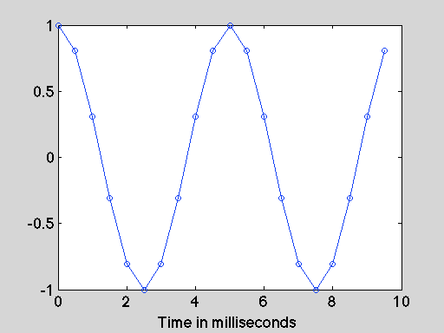
Fourier Analysis (Fourier Transform)
e But how can we take the inner product of a signal with tones?
e Signals are just sequences of numbers, vectors!
e In this example, a new number (called a sample) every .5 ms
1.0000
0.8090
0.3090
-0.3090
-0.8090
-1.0000
-0.8090
-0.3090
0.3090
0.8090
1.0000
0.8090
0.3090
-0.3090
-0.8090
-1.0000
-0.8090
-0.3090
0.3090
0.8090
200 Hz tone
Lecture 20: Fourier Transform and Speech

Slide 6
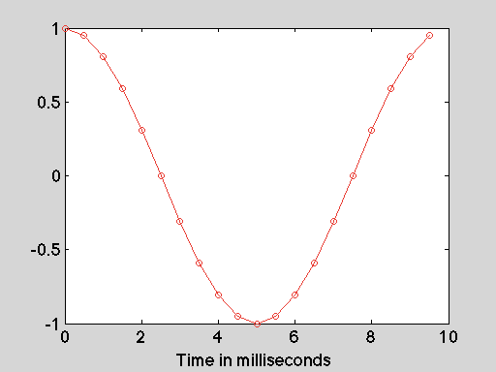
Fourier Analysis (Fourier Transform)
1.0000
0.9511
0.8090
0.5878
0.3090
0.0000
-0.3090
-0.5878
-0.8090
-0.9511
-1.0000
-0.9511
-0.8090
-0.5878
-0.3090
-0.0000
0.3090
0.5878
0.8090
0.9511
100 Hz tone
Lecture 20: Fourier Transform and Speech

Slide 7
Fourier Analysis via inner product
e Let’s treat the 200 Hz tone as our signal whose spectrum we want to measure.
e Take inner product with 100 Hz, 200 Hz...500 Hz, etc.
Lecture 20: Fourier Transform and Speech
Notes:
נראה דוגמה מספרית.

Slide 8
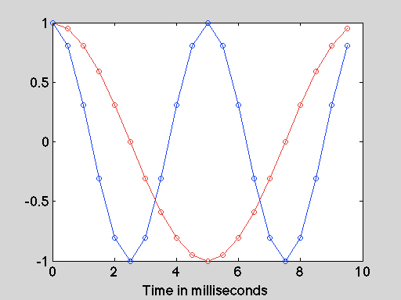
e There are times where the product is large where both vectors are positive, but each one is exactly canceled by a time when the vectors have opposite signs, so the product is negative. The sum (IP) is zero.
s200
s100
s200.*s100
1.0000
0.8090
0.3090
1.0000
0.9511
0.8090
1.0000
0.7694
0.2500
-0.3090
-0.8090
-1.0000
-0.8090
-0.3090
0.3090
0.8090
0.5878
0.3090
0.0000
-0.3090
-0.5878
-0.8090
-0.9511
-1.0000
-0.1816
-0.2500
-0.0000
0.2500
0.1816
-0.2500
-0.7694
1.0000
0.8090
0.3090
-0.3090
-0.8090
-1.0000
-0.8090
-0.3090
0.3090
0.8090
-1.0000
-0.7694
-0.2500
0.1816
0.2500
0.0000
-0.2500
-0.1816
0.2500
0.7694
-0.9511
-0.8090
-0.5878
-0.3090
-0.0000
0.3090
0.5878
0.8090
0.9511
Sum =
0
Lecture 20: Fourier Transform and Speech
Notes:
תסמכו עליי שהמכפלה הפנימית הזאת יוצאת 0- כי אין תדר של 100 הרץ ב200 הרץ.

Slide 9
s200 |  | s200 |  | s200.*s200
1.0000 |  | 1.0000 |  | 1.0000
0.8090 |  | 0.8090 |  | 0.6545
0.3090 |  | 0.3090 |  | 0.0955
-0.3090 |  | -0.3090 |  | 0.0955
-0.8090 |  | -0.8090 |  | 0.6545
-1.0000 |  | -1.0000 |  | 1.0000
-0.8090 |  | -0.8090 |  | 0.6545
-0.3090 |  | -0.3090 |  | 0.0955
0.3090 |  | 0.3090 |  | 0.0955
0.8090 |  | 0.8090 |  | 0.6545
1.0000 |  | 1.0000 |  | 1.0000
0.8090 |  | 0.8090 |  | 0.6545
0.3090 |  | 0.3090 |  | 0.0955
-0.3090 |  | -0.3090 |  | 0.0955
-0.8090 |  | -0.8090 |  | 0.6545
-1.0000 |  | -1.0000 |  | 1.0000
-0.8090 |  | -0.8090 |  | 0.6545
-0.3090 |  | -0.3090 |  | 0.0955
0.3090 |  | 0.3090 |  | 0.0955
0.8090 |  | 0.8090 |  | 0.6545
Sum = 10
Lecture 20: Fourier Transform and Speech
Notes:
אבל200 הרץ זה 200 הרץ. הפקטור 10 נובע מנרמול.

Slide 10
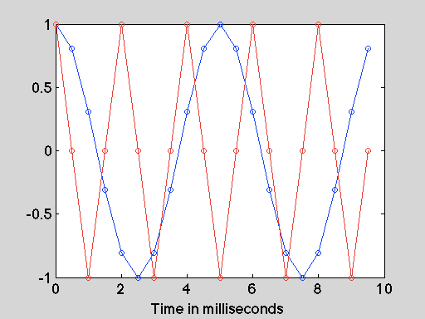
s200 |  | s500 |  | s200.*s500
1.0000 |  | 1.0000 |  | 1.0000
0.8090 |  | 0.0000 |  | 0.0000
0.3090 |  | -1.0000 |  | -0.3090
-0.3090 |  | -0.0000 |  | 0.0000
-0.8090 |  | 1.0000 |  | -0.8090
-1.0000 |  | 0.0000 |  | -0.0000
-0.8090 |  | -1.0000 |  | 0.8090
-0.3090 |  | -0.0000 |  | 0.0000
0.3090 |  | 1.0000 |  | 0.3090
0.8090 |  | 0.0000 |  | 0.0000
1.0000 |  | -1.0000 |  | -1.0000
0.8090 |  | -0.0000 |  | -0.0000
0.3090 |  | 1.0000 |  | 0.3090
-0.3090 |  | -0.0000 |  | 0.0000
-0.8090 |  | -1.0000 |  | 0.8090
-1.0000 |  | -0.0000 |  | 0.0000
-0.8090 |  | 1.0000 |  | -0.8090
-0.3090 |  | -0.0000 |  | 0.0000
0.3090 |  | -1.0000 |  | -0.3090
0.8090 |  | -0.0000 |  | -0.0000
Sum = 0
Lecture 20: Fourier Transform and Speech

Slide 11
Fourier Analysis via inner product
e Other frequencies will also give 0 as the IP, so this our resulting spectrum:
10
8
6
4
2
IP
0
0
200
400 600
Frequency (Hz)
800
1000
e This will also work with more complex signals!
Lecture 20: Fourier Transform and Speech

Slide 12
Example recognizer: Match unknown (test) vowels from one speaker to template vowels from another speaker
Select a short waveform chunk from each template and test vowel.
Save waveform chunks to file and import into a matrix in Matlab python
Derive the spectrum of each vowel by using the Fourier Transform: take the inner product of the vowel waveform with the waveforms of a series of tones with different frequencies.
Compare the similarity of each test vowel to each template vowel by taking the inner product of the spectrum of the test vowel with each template vowel:
⁾ Recognition: The largest IP value obtained for a given test vowel is the vowel that our recognizer selects as the one spoken.
Lecture 20: Fourier Transform and Speech

Slide 13
Perform Fourier Transform for each vowel
e Take the inner product of each vowel waveform (vector) with the waveform of tones from 100 Hz to 3000 Hz, in steps of 100 Hz.
e The resulting vector of inner products for each of the 30 frequencies is the spectrum.
e The tone waveforms are stored in a matrix called freqs.
e Each column is a different frequency. The rows contain the successive time samples.
>>size (freqs) ans =
2000 30
Lecture 20: Fourier Transform and Speech

Slide 14
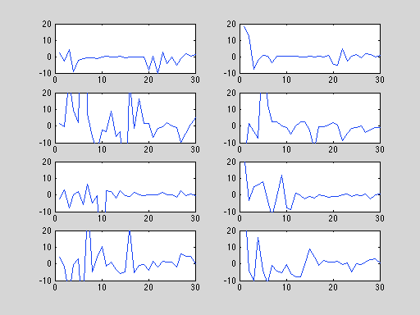
Perform Fourier Transform for each vowel
e Plot the resulting spectra
Template
Test
%plot_spec
IY
for i = 1:4
subplot (4,2,2*i-1), plot(spec_temp(:,i));
subplot (4,2,2*i-1), ylim([-10 20]);
subplot (4,2,2*i), plot(spec_test(:,i));
subplot (4,2,2*i),ylim([-10 20]);
EH
end
AA
AH
Lecture 20: Fourier Transform and Speech

Slide 15
Compare each unknown vowels to all the templates
e Go thru each test vowel in a loop.
e For each test vowel, go through each template vowel in a loop and take the IP.
e Save the IP in a matrix in which the rows correspond to the test vowels and the columns the template vowels.
%do_test for j = 1:4
for i=1:4
IP(j,i) = sum((spec_test(:,j)-mean(spec_test(:,j))).*(spec_temp(:,i)-mean(spec_temp(:,i))));
end
end
>>IP
IP =
1.0e+03 *
0.0023 | -0.2601 | 0.0546 | 0.0495
0.0855 | 1.1562 | 0.1832 | -0.5468
-0.0204 | -0.4350 | 0.2976 | -0.3989
-0.0648 | -1.5917 | 0.0845 | 0.7764
Lecture 20: Fourier Transform and Speech

Slide 16
Results
e How do we interpret the IP matrix?
e Each row has the results for one test vowel, comparing it to all template vowels, across the columns
Template
IY
EH
AA
AH
IY
0.0023 -0.2601 0.0546 0.0495
Test
^{EH} 0.0855 ^{AA} -0.0204 | 1.1562 0.1832 -0.4350 0.2976 | -0.5468 -0.3989
^{AH} -0.0648 | -1.5917 0.0845 | 0.7764
e The largest IP for each test vowel is the vowel category our system has recognized for that vowel
e If our recognizer worked, the diagonal cells of the matrix should be larger than the off-diagonal cells.
e 3 vowels were correctly recognized. One was not (/IY/).
Lecture 20: Fourier Transform and Speech

Slide 17
Important functions in numpy
e Numpy is a math library in python that does a lot of things
e linspace: Return evenly spaced numbers over a specified interval
e sin: Computes sinus of number
Lecture 20: Fourier Transform and Speech

Slide 18
Important functions in scipy
e Numpy is a science library in python that does a lot of things
e io.wavfile: Reads wav files – returns the sample rate and the data
e fftpack.fft: Computes fft of data vector (fourier transform)
Lecture 20: Fourier Transform and Speech

